Slide 1


Wynnewood Acres Terrace Reconstruction
June 14, 2016

Slide 2


Presentation Roadmap
What is ReBuild Houston?
Overview of Project
Next Steps Timeline
Contact information

Slide 3
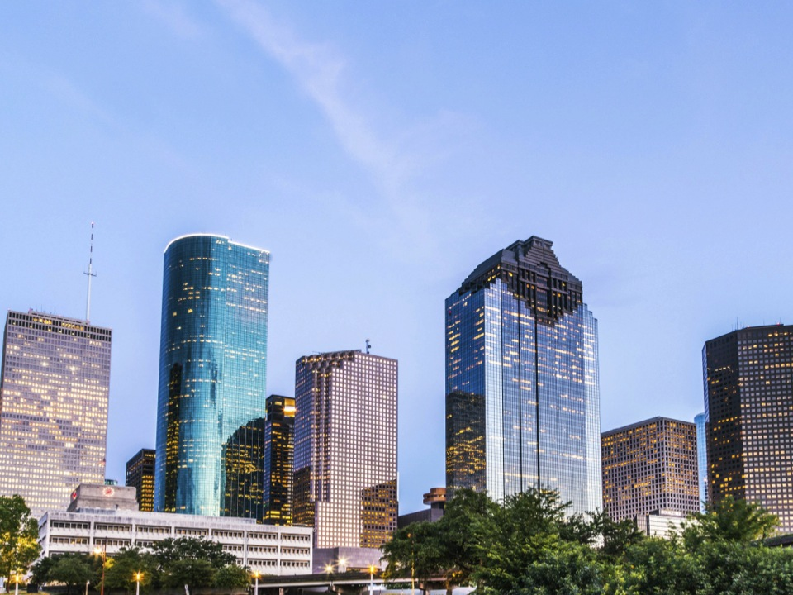
What is ReBuild Houston?
Approved by voters in 2010
Pay-as-you-go approach (no new debt)
Greatest need areas first (with greatest benefit to communities)
3
Notes:
Good afternoon.
Thanks you for coming out for the Wynnewood Arces Reconstruction project community meeting, which was made possible by PWE’s ReBuild Houston Program.
A quick show of hands…how many people have heard about ReBuild Houston before today’s meeting?

Slide 4
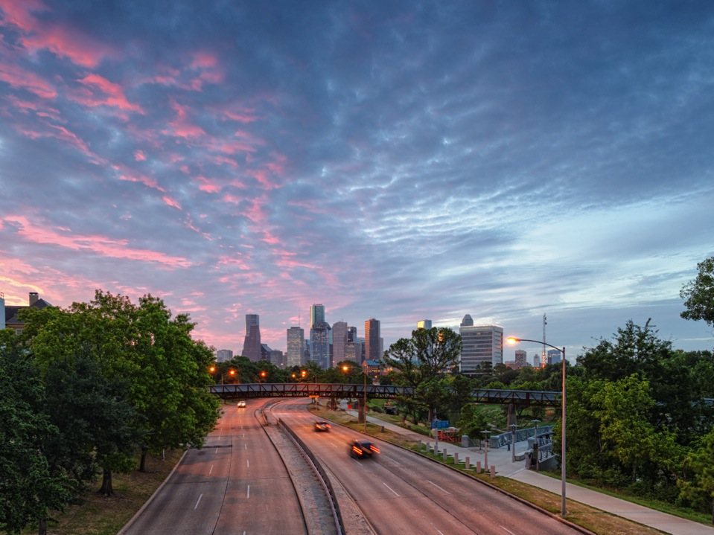
ReBuild Houston Goals
Reduce flooding
Improve mobility
Quality of life
4
Notes:
The ReBuild Houston program has the same goals as many of you. Reduce the amount of time you spend sitting in traffic, keep your areas from flooding, and improve your quality of life by addressing your mobility needs whether they are by car, bus, bike, or on foot.
To date RBH has spent $655 million on projects such as the upcoming reconstruction of your neighborhood, but the best is yet to come. As the fund grows we will spend more than $2 billion on street and drainage improvements over the next 10 years without incurring any additional debt. And your participation in these community meeting will shape what the neighborhood will look like for the next 50 years.
But let’s not get too far ahead, we are here to talk about Wynnewood.

Slide 5
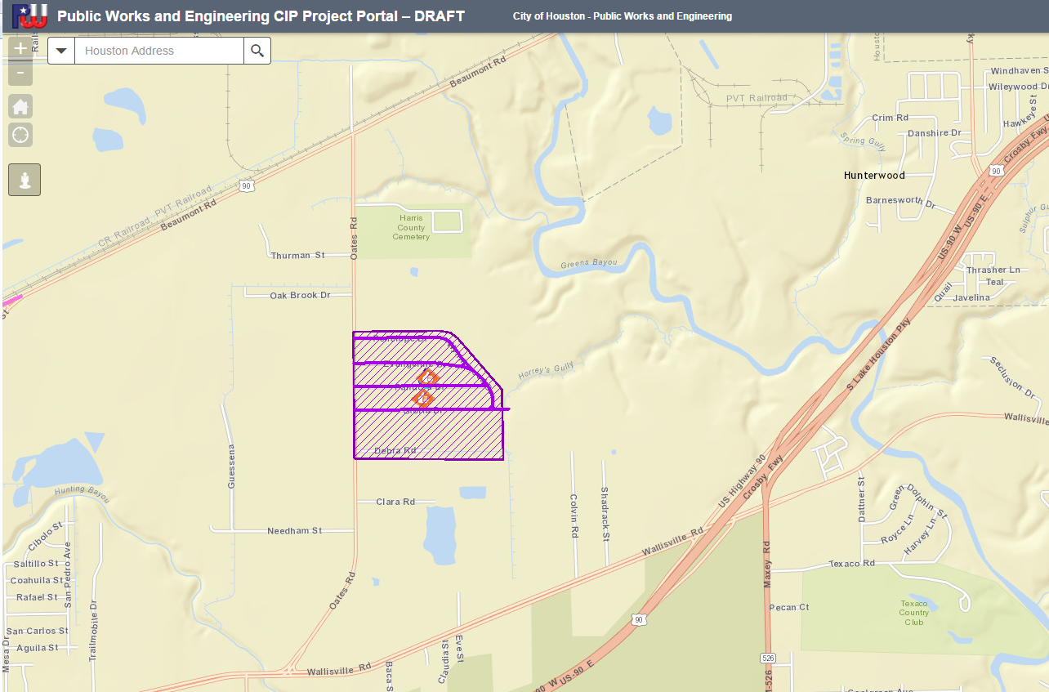
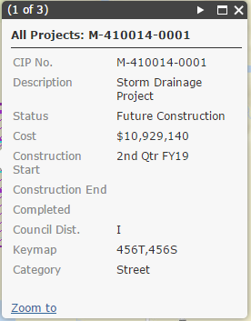
www.RebuildHouston.org
Future Construction
Completed Construction
Current Construction
5
Notes:
Rebuild Houston viewer screen shot
Wynnewood Acres Reconstruction
M-410014
Design 2016
Construction 2019

Slide 6
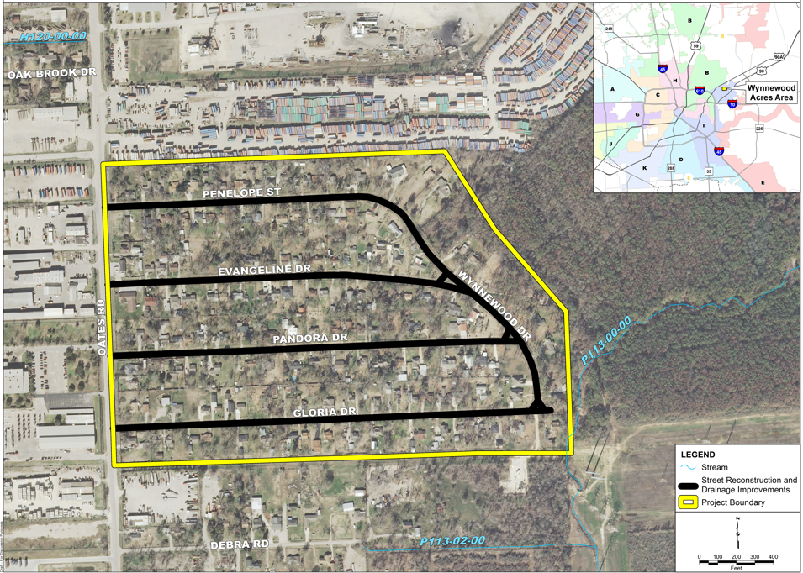
WYNNEWOOD ACRES
RECONSTRUCTION
6
Notes:
Here is a full snapshot of the area being reconstructed.
5 streets
Penelope
Evangeline
Pandora
Gloria
Wynnewood

Slide 7

Identified Needs
Top Priority:
Inadequate storm drainage system
Other Needs:
Pavement Condition
Sidewalks and ramps

Slide 8
Identified Needs
Limited Capacity
Overgrown Ditch
No Sidewalks
Patching

Slide 9
Existing Flow Path
9
Notes:
Existing Flow Path
Overland storm water flowing through some properties.

Slide 10


Project Highlights
Increasing capacity of storm drainage by replacing existing ditches with pipe and swale system
Other Considerations/Efforts:
Replace existing asphalt streets with concrete pavement
Update water and sewer infrastructure as necessary
Install 5 foot sidewalks and ramps
Notes:
We are designing the pipe system to take the standard 1-2” rain event and designing the roads to manage the larger rain storms (8-12”). So that the sheetflow gets out of the neighborhood (to Buffalo Bayou)

Slide 11
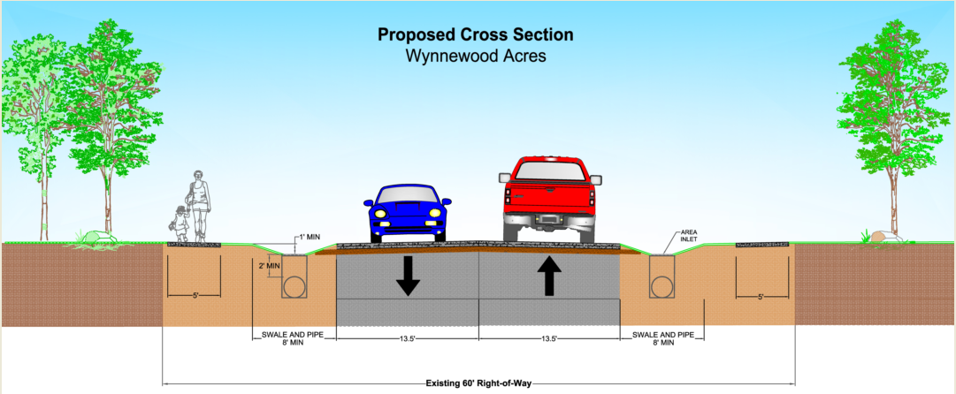
Typical Cross Section
11

Slide 12
Proposed Flow Path
12
Notes:
Sheet flow after Street and Storm Improvements

Slide 13

Next Steps
WYNNEWOOD ACRES RECONSTRUCTION
2013
Planning (complete)
2016
Design
(ongoing)
2020
Anticipated Completion
2019
Construction
Timeline subject to change
13
Notes:
Will be a pre-construction meeting PRIOR TO THE START OF CONSTRUCTION to answer all logistical questions. There will also be updates throughout construction (available on the website?).

Slide 14
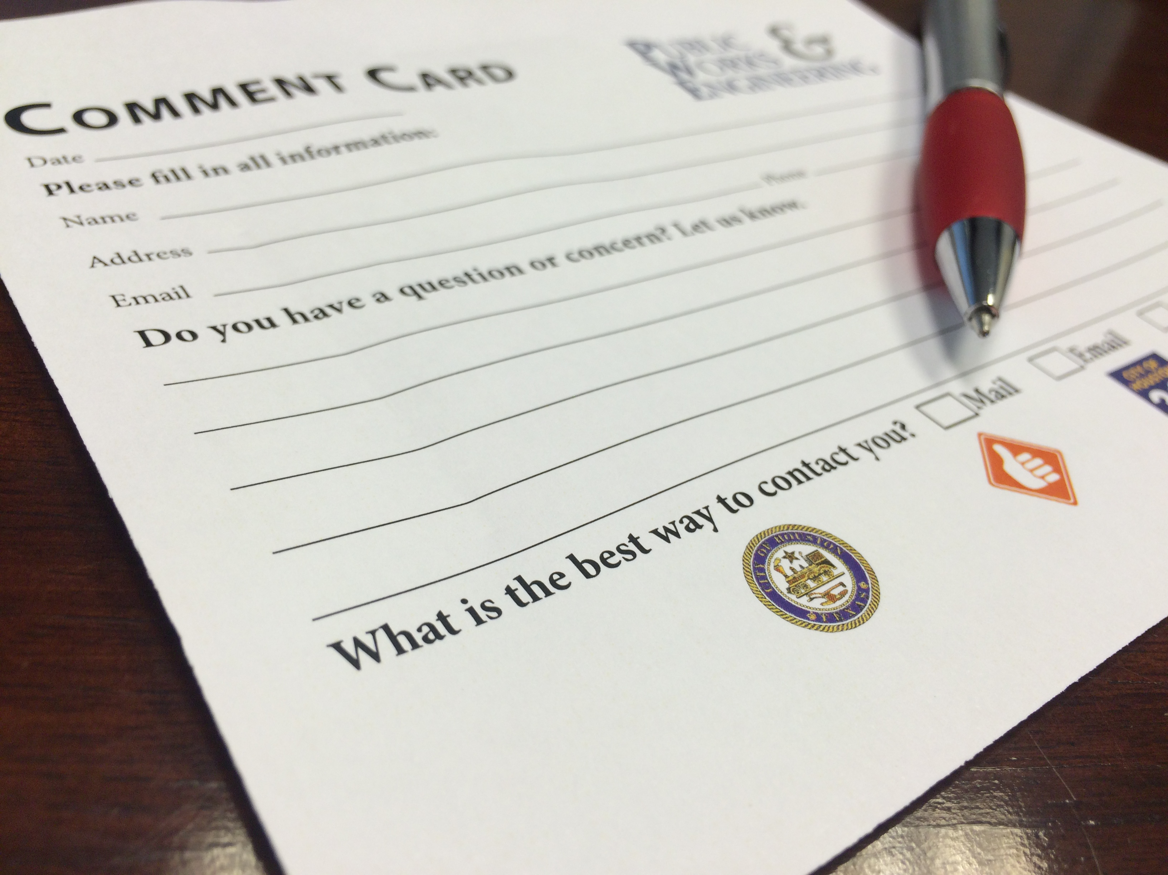
Time for Breakout Session!
Or email us your comments at: pweplanning@houstontx.gov
www.RebuildHouston.org
Provide your input BEFORE July 15, 2016
Notes:
Now its time for the second break out session. Remember what is presented is our plan for the project, but we want to hear from you
So please make sure you fill out a comment card if you have any question or comments to make sure your input is heard

